Slide 1

INDUSTRY SESSION
UNDERSTANDING STOCK MARKETS USING DATA SCIENCE
By: Deepak Gupta

Slide 2




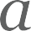


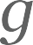


Objective
Understand the basics of Financial Trading
What is a Technical Indicator?
What are Trading Signals?
Strategy Return Analysis

Slide 3
INDUSTRY SESSION
This Session is for Education Purpose only.
Great Learning will not be responsible for any result of live trades.
Proprietary content. ©Great Learning. All Rights Reserved. Unauthorized use or distribution prohibited

Slide 4
INDUSTRY SESSION
Financial Trading
WHAT IS IT? HOW IS IT DONE ? TIPS & TRICKS ?
Proprietary content. ©Great Learning. All Rights Reserved. Unauthorized use or distribution prohibited

Slide 5
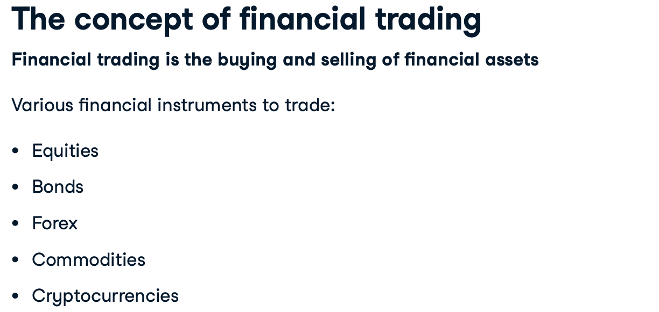
INDUSTRY SESSION
Financial Trading
Proprietary content. ©Great Learning. All Rights Reserved. Unauthorized use or distribution prohibited

Slide 6
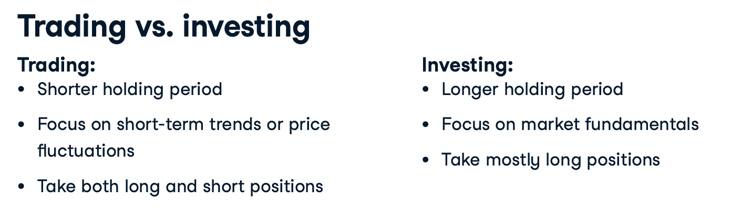
INDUSTRY SESSION
Financial Trading
Proprietary content. ©Great Learning. All Rights Reserved. Unauthorized use or distribution prohibited

Slide 7
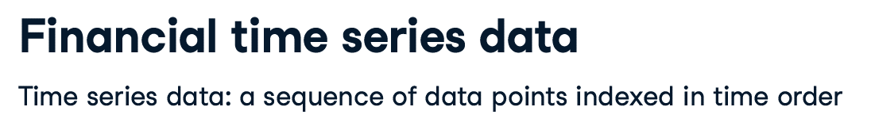
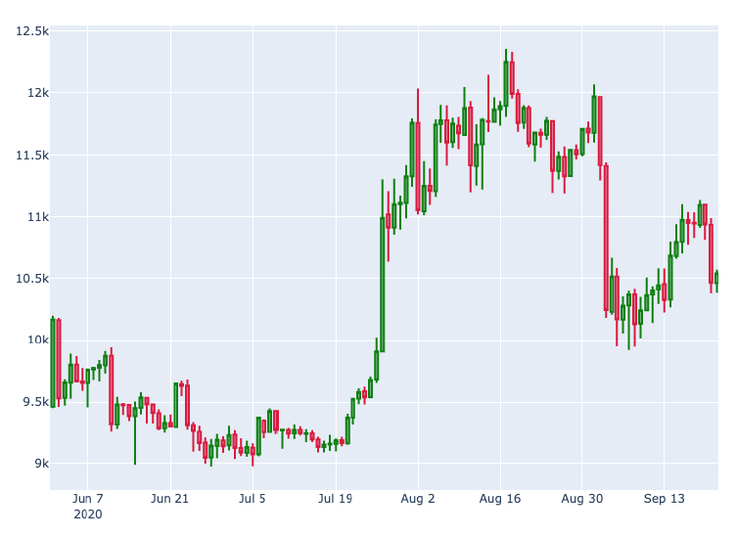
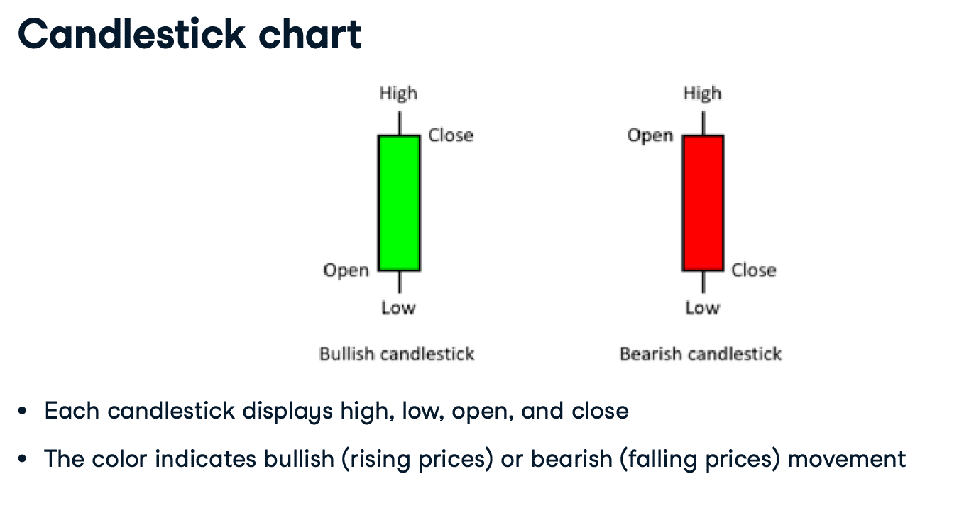
INDUSTRY SESSION
Financial Trading
Proprietary content. ©Great Learning. All Rights Reserved. Unauthorized use or distribution prohibited

Slide 8
INDUSTRY SESSION
Technical Indicators
WHAT IS IT? TYPE OF INDICATORS? HOW WILL IT HELP ?
Proprietary content. ©Great Learning. All Rights Reserved. Unauthorized use or distribution prohibited

Slide 9
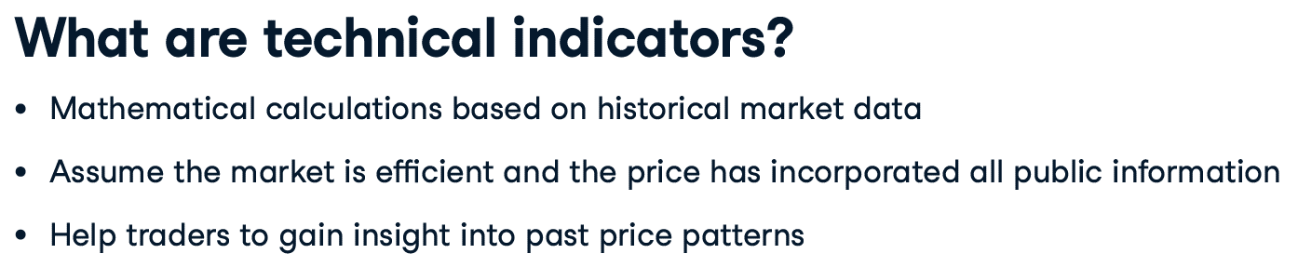
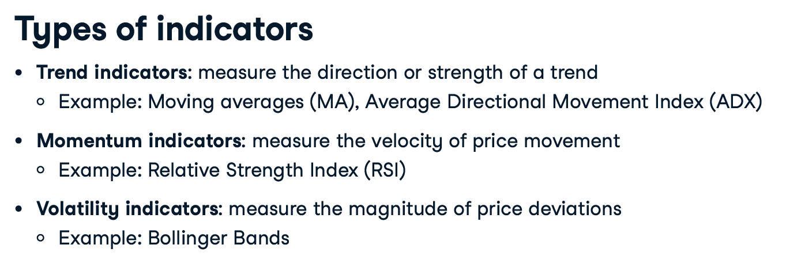
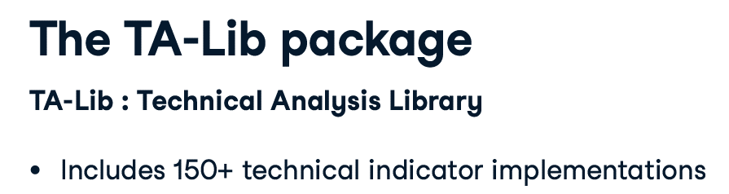
INDUSTRY SESSION
Technical Indicators
Difficult to install, instructions will be shared along with Session Files
Proprietary content. ©Great Learning. All Rights Reserved. Unauthorized use or distribution prohibited

Slide 10
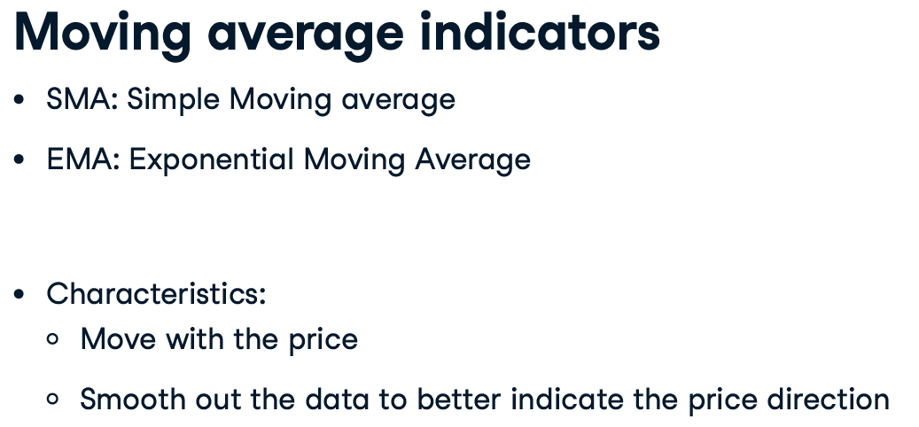
INDUSTRY SESSION
Technical Indicators
Proprietary content. ©Great Learning. All Rights Reserved. Unauthorized use or distribution prohibited

Slide 11
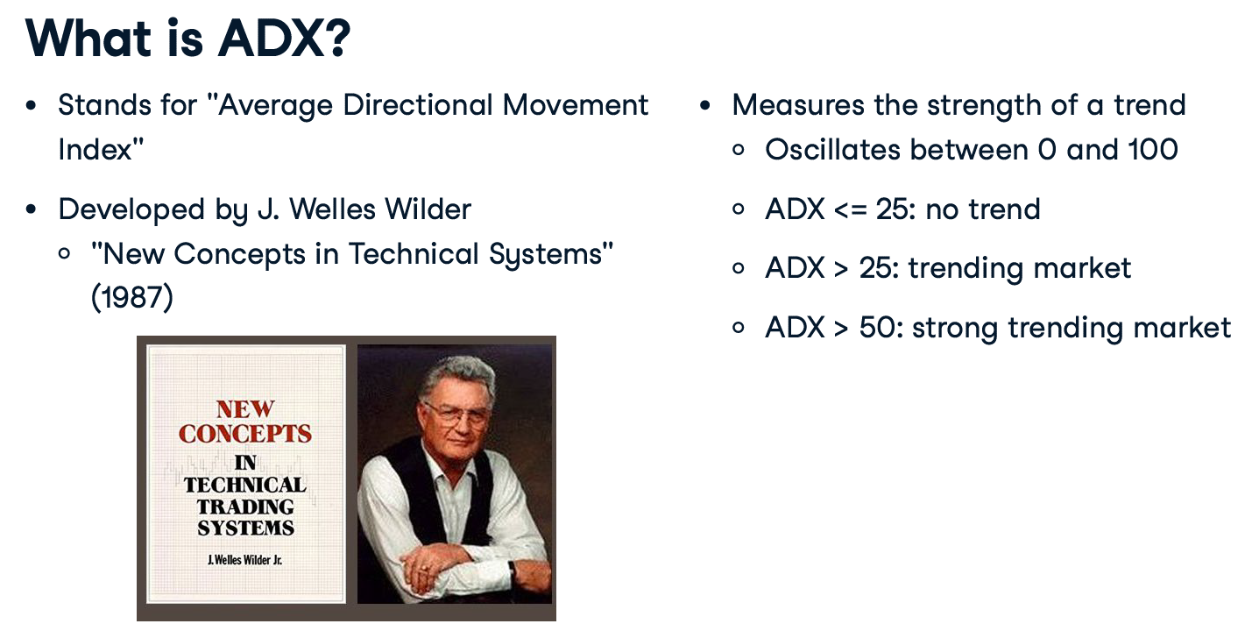
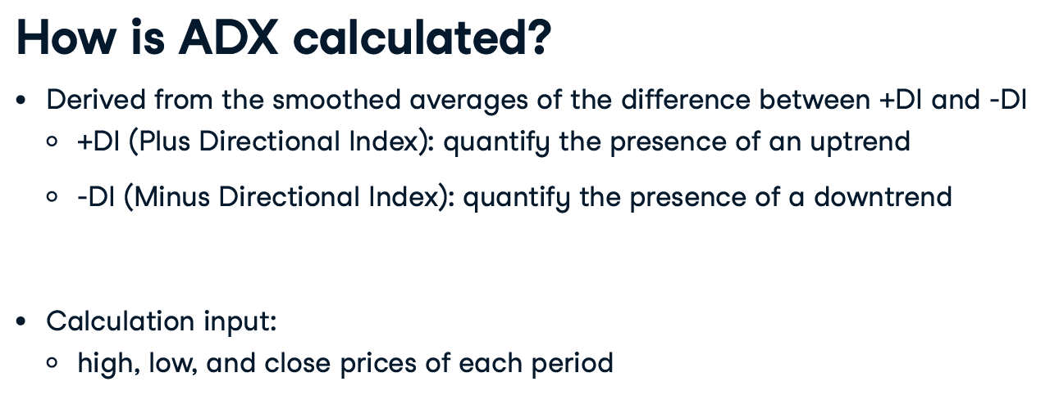
INDUSTRY SESSION
Technical Indicators
Strength Indicator: ADX
Proprietary content. ©Great Learning. All Rights Reserved. Unauthorized use or distribution prohibited

Slide 12
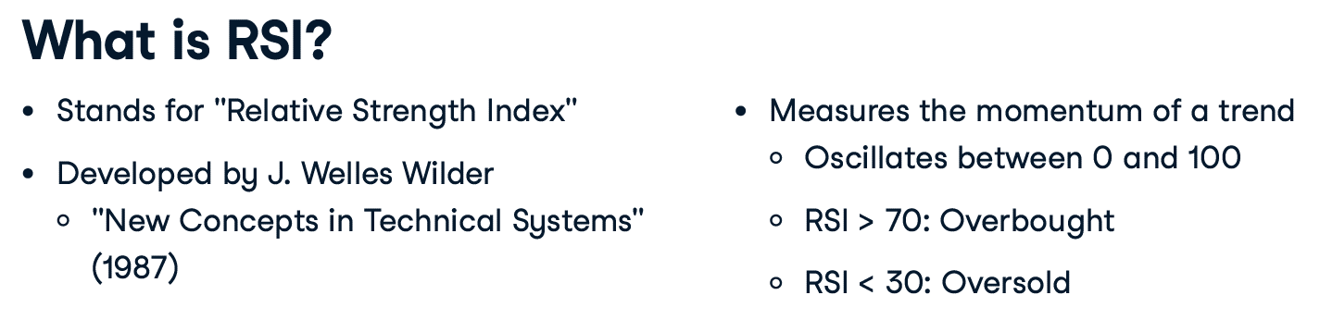
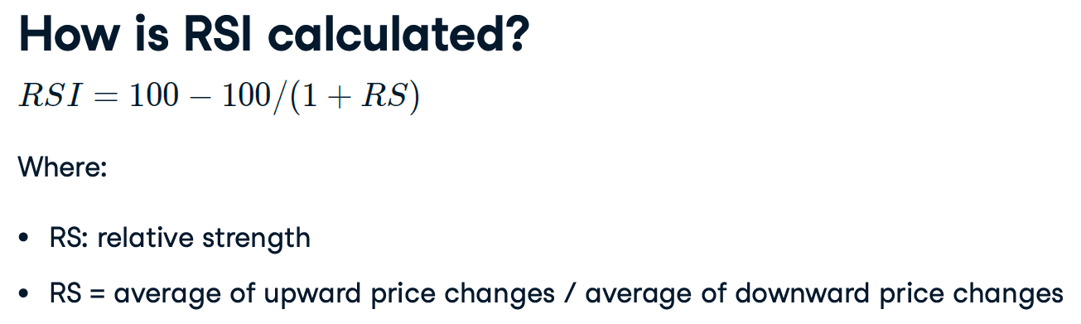
INDUSTRY SESSION
Technical Indicators
Momentum Indicator: RSI
Proprietary content. ©Great Learning. All Rights Reserved. Unauthorized use or distribution prohibited

Slide 13
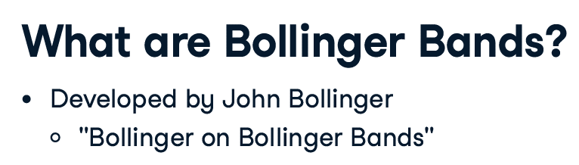
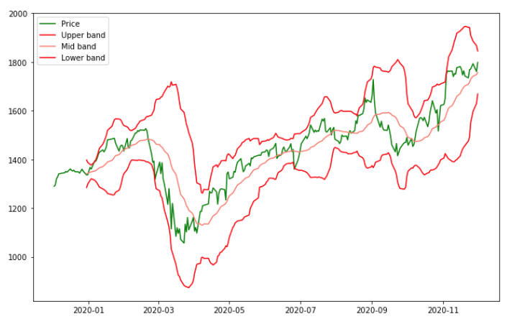
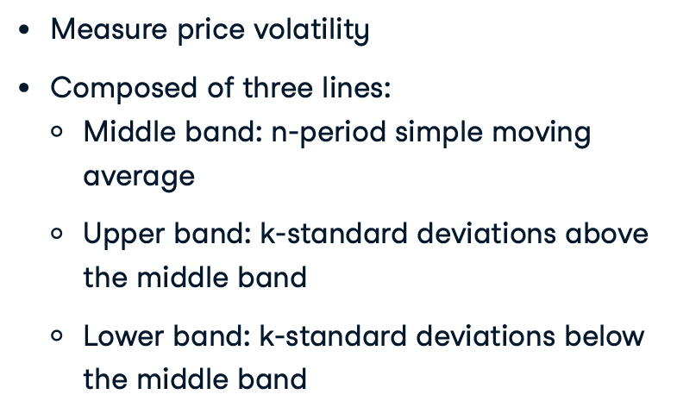
INDUSTRY SESSION
Technical Indicators
Volatility Indicator: Bollinger Bands
Proprietary content. ©Great Learning. All Rights Reserved. Unauthorized use or distribution prohibited

Slide 14
INDUSTRY SESSION
Trading Signals
WHAT IS IT? HOW TO GENERATE? IMPLEMENTATION IN PYTHON ?
Proprietary content. ©Great Learning. All Rights Reserved. Unauthorized use or distribution prohibited

Slide 15
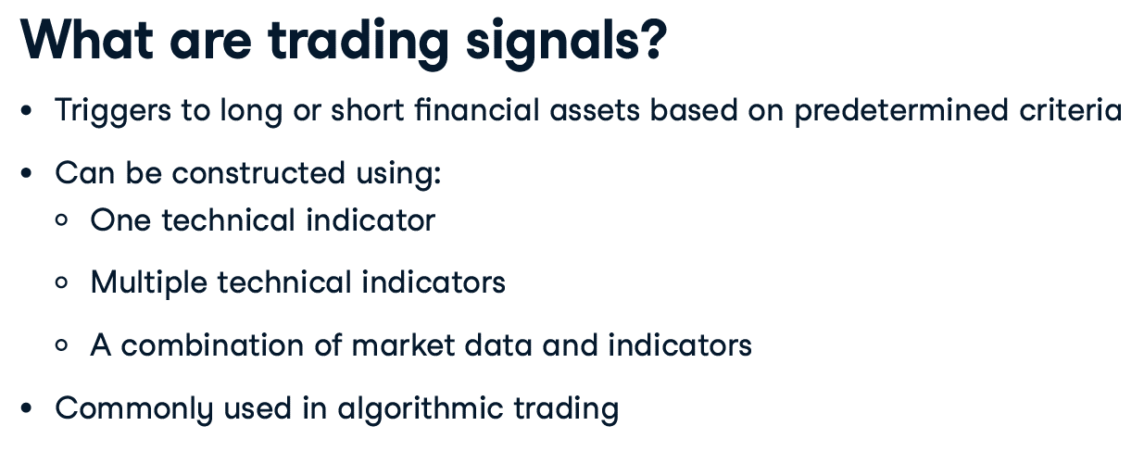
INDUSTRY SESSION
Trading Signals
Proprietary content. ©Great Learning. All Rights Reserved. Unauthorized use or distribution prohibited

Slide 16
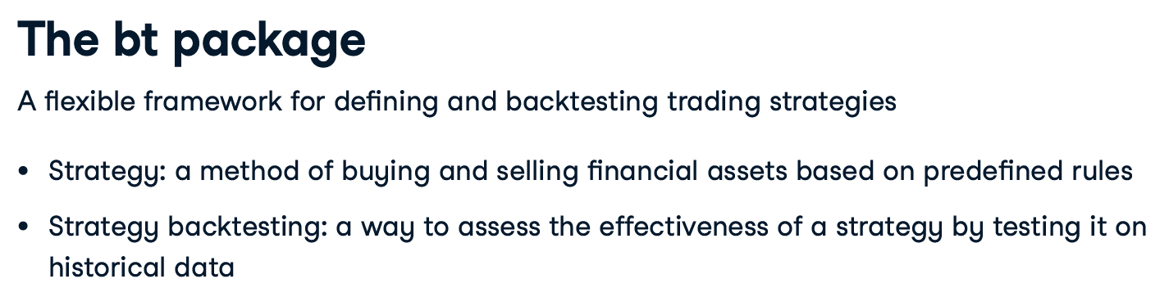
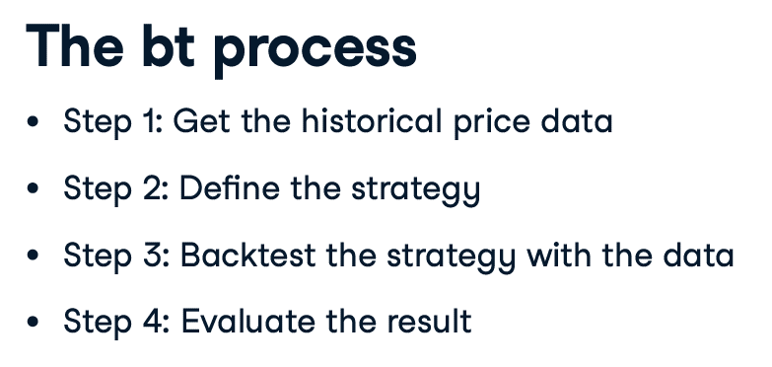
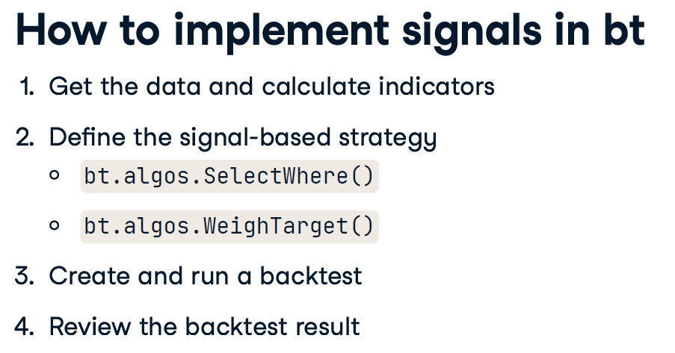
INDUSTRY SESSION
Trading Signals
Proprietary content. ©Great Learning. All Rights Reserved. Unauthorized use or distribution prohibited

Slide 17
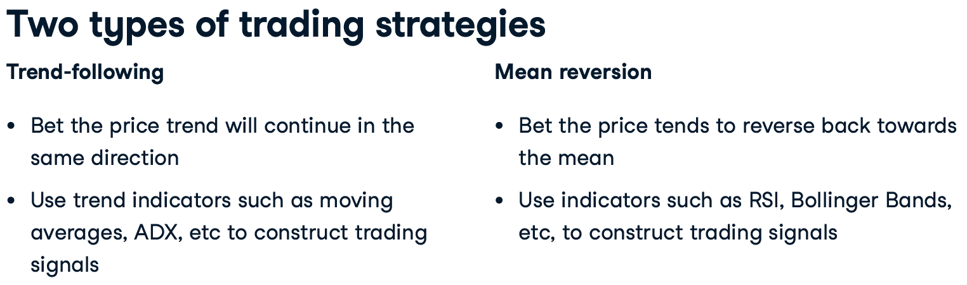
INDUSTRY SESSION
Trading Signals
Proprietary content. ©Great Learning. All Rights Reserved. Unauthorized use or distribution prohibited

Slide 18
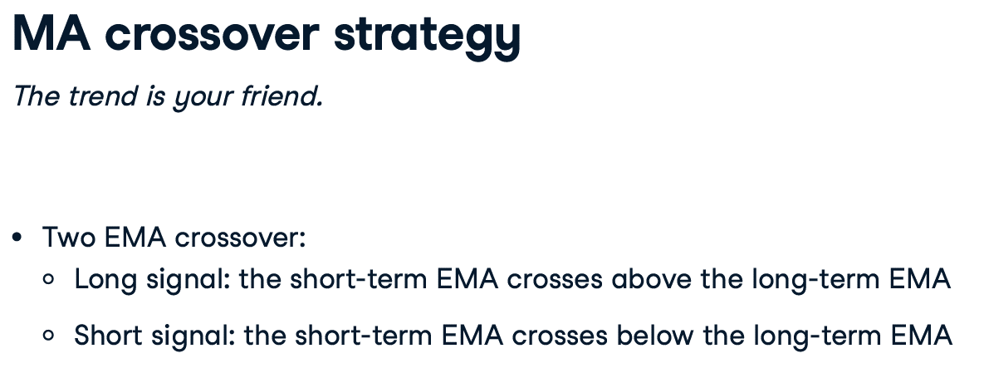
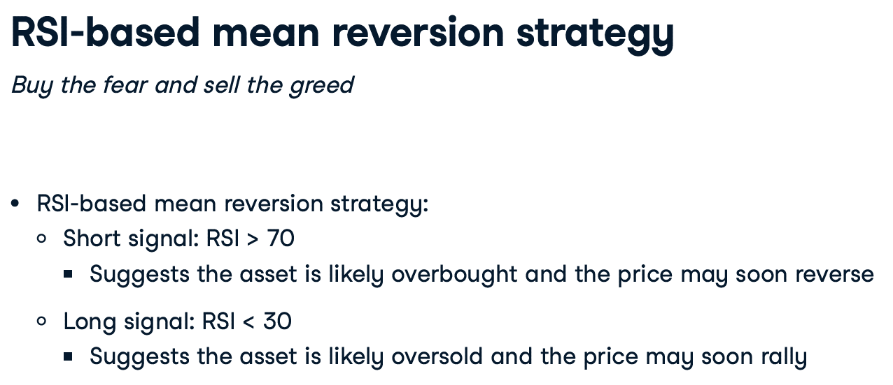
INDUSTRY SESSION
Trading Signals
Proprietary content. ©Great Learning. All Rights Reserved. Unauthorized use or distribution prohibited

Slide 19
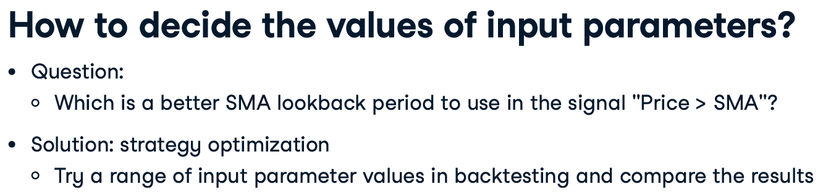
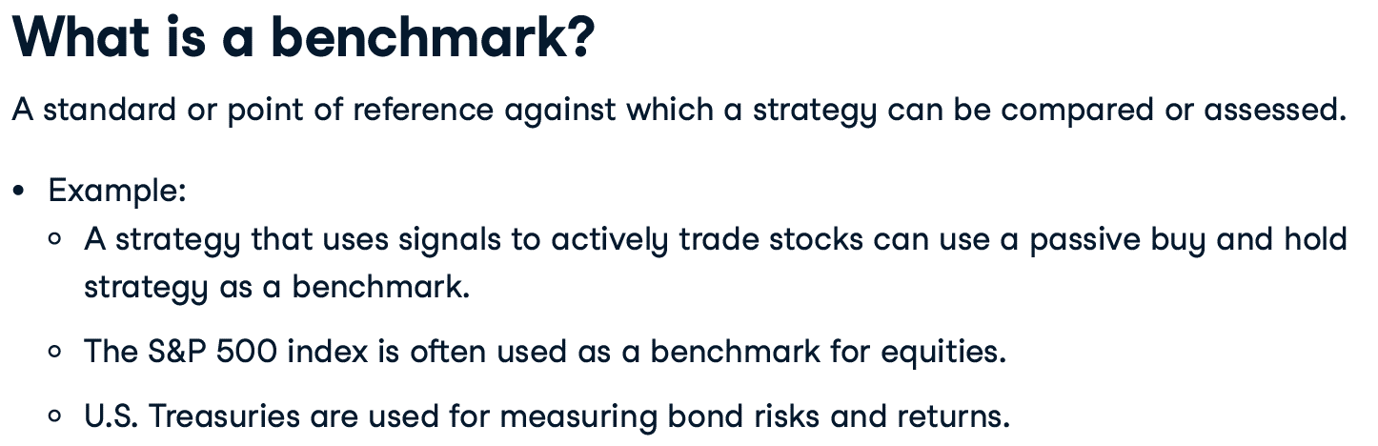
INDUSTRY SESSION
Trading Signals
Proprietary content. ©Great Learning. All Rights Reserved. Unauthorized use or distribution prohibited

Slide 20
INDUSTRY SESSION
Strategy Return Analysis
WHAT IS IT? EVALUATION MENTHODS? IMPLEMENTATION IN PYTHON ?
Proprietary content. ©Great Learning. All Rights Reserved. Unauthorized use or distribution prohibited

Slide 21
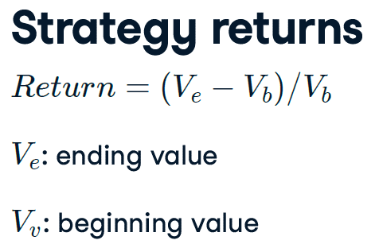
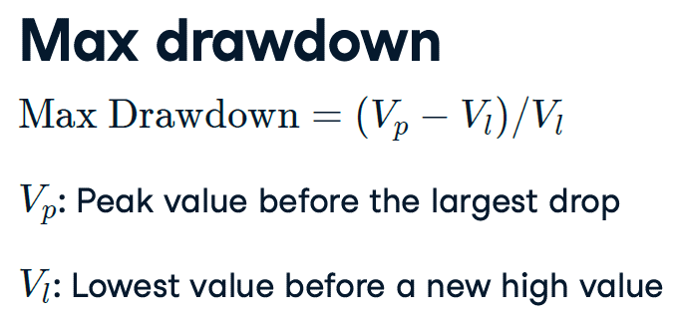
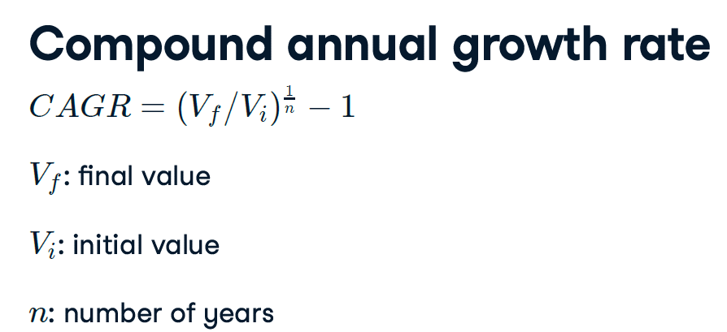
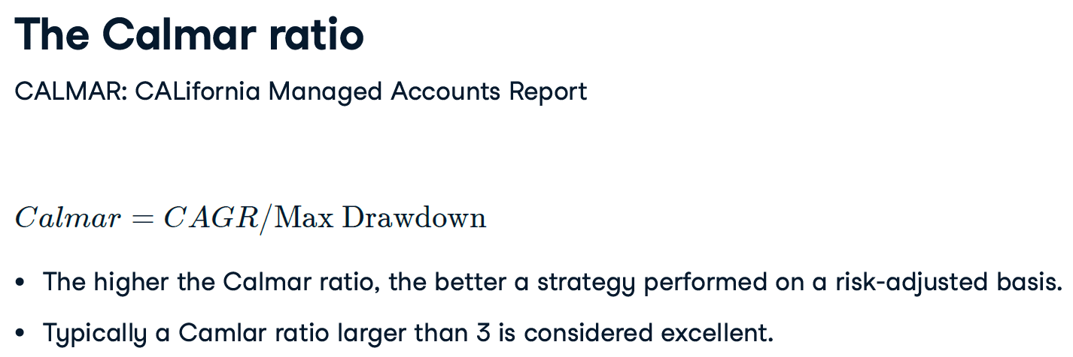
INDUSTRY SESSION
Strategy Return Analysis
Proprietary content. ©Great Learning. All Rights Reserved. Unauthorized use or distribution prohibited

Slide 22
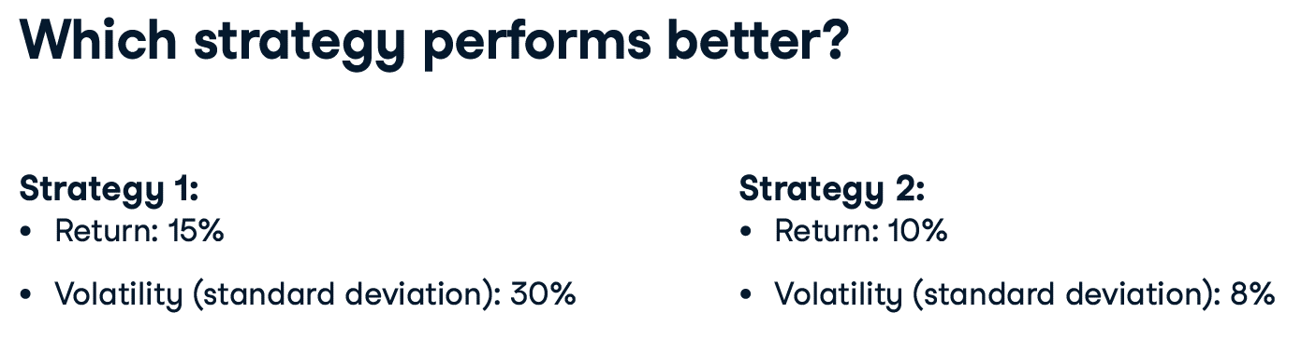
INDUSTRY SESSION
Strategy Return Analysis
Proprietary content. ©Great Learning. All Rights Reserved. Unauthorized use or distribution prohibited

Slide 23
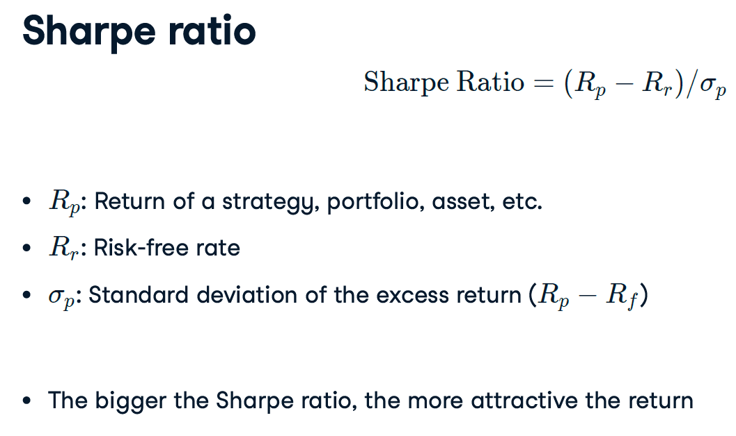
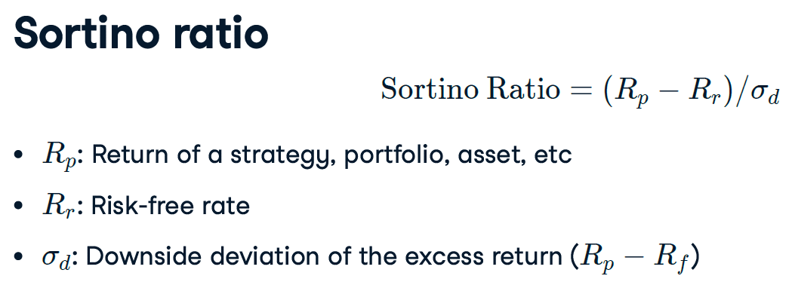
INDUSTRY SESSION
Strategy Return Analysis
Proprietary content. ©Great Learning. All Rights Reserved. Unauthorized use or distribution prohibited

Slide 24









HAPPY LEARNING

